Slide 1

Creating a Simple PowerShell Repository with Sleet Adam Driscoll
Notes:
Slide 0: this slide will not automatically turned over. Show this BEFORE the acutal presentation starts.

Slide 2
About Me
Owner of Ironman Software
Inventor of PowerShell Universal
Former PowerShell MVP
Blogger
Author
YouTuber
Open-Source Contributor
Hobby Collector

Slide 3
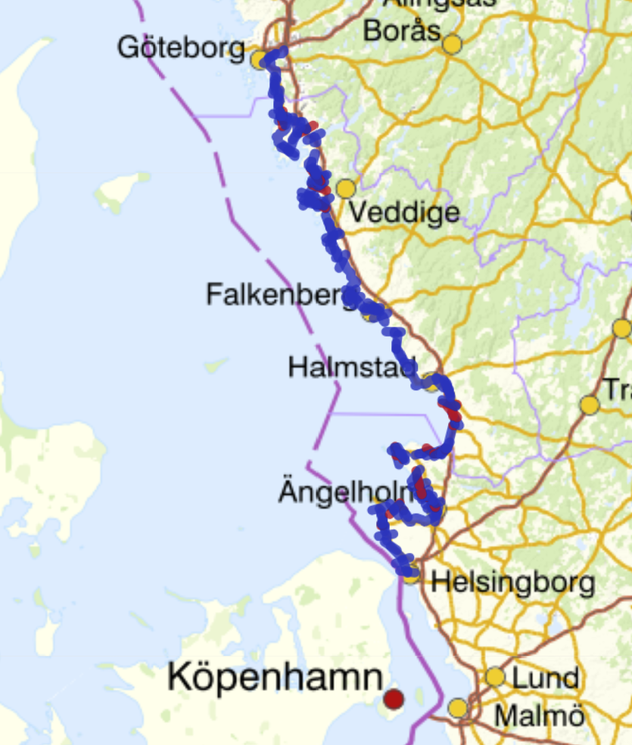
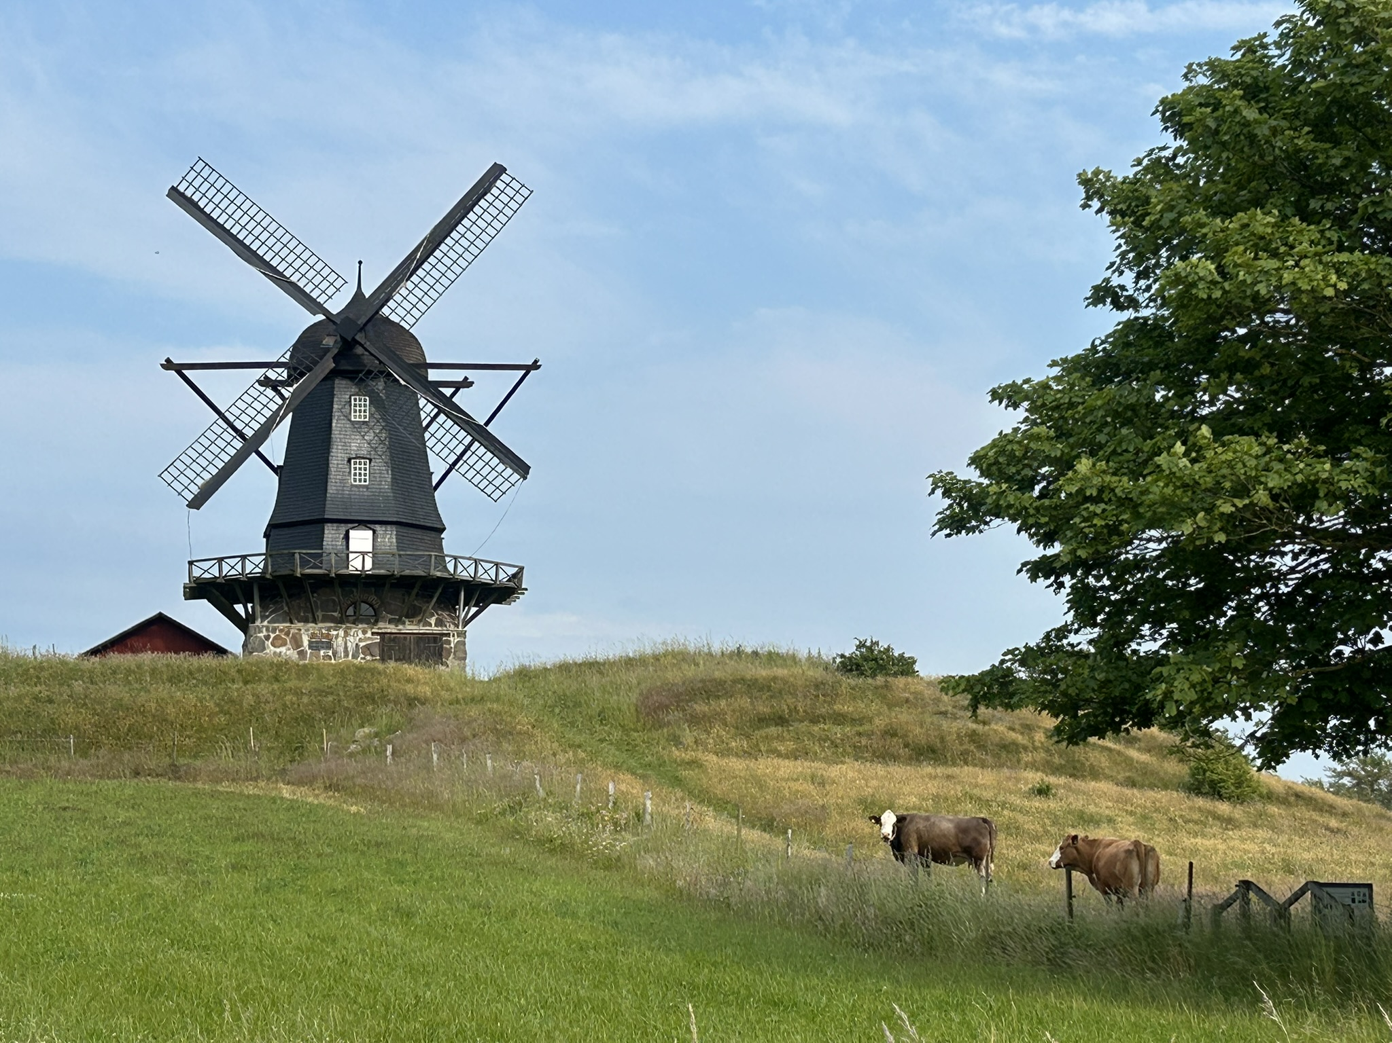
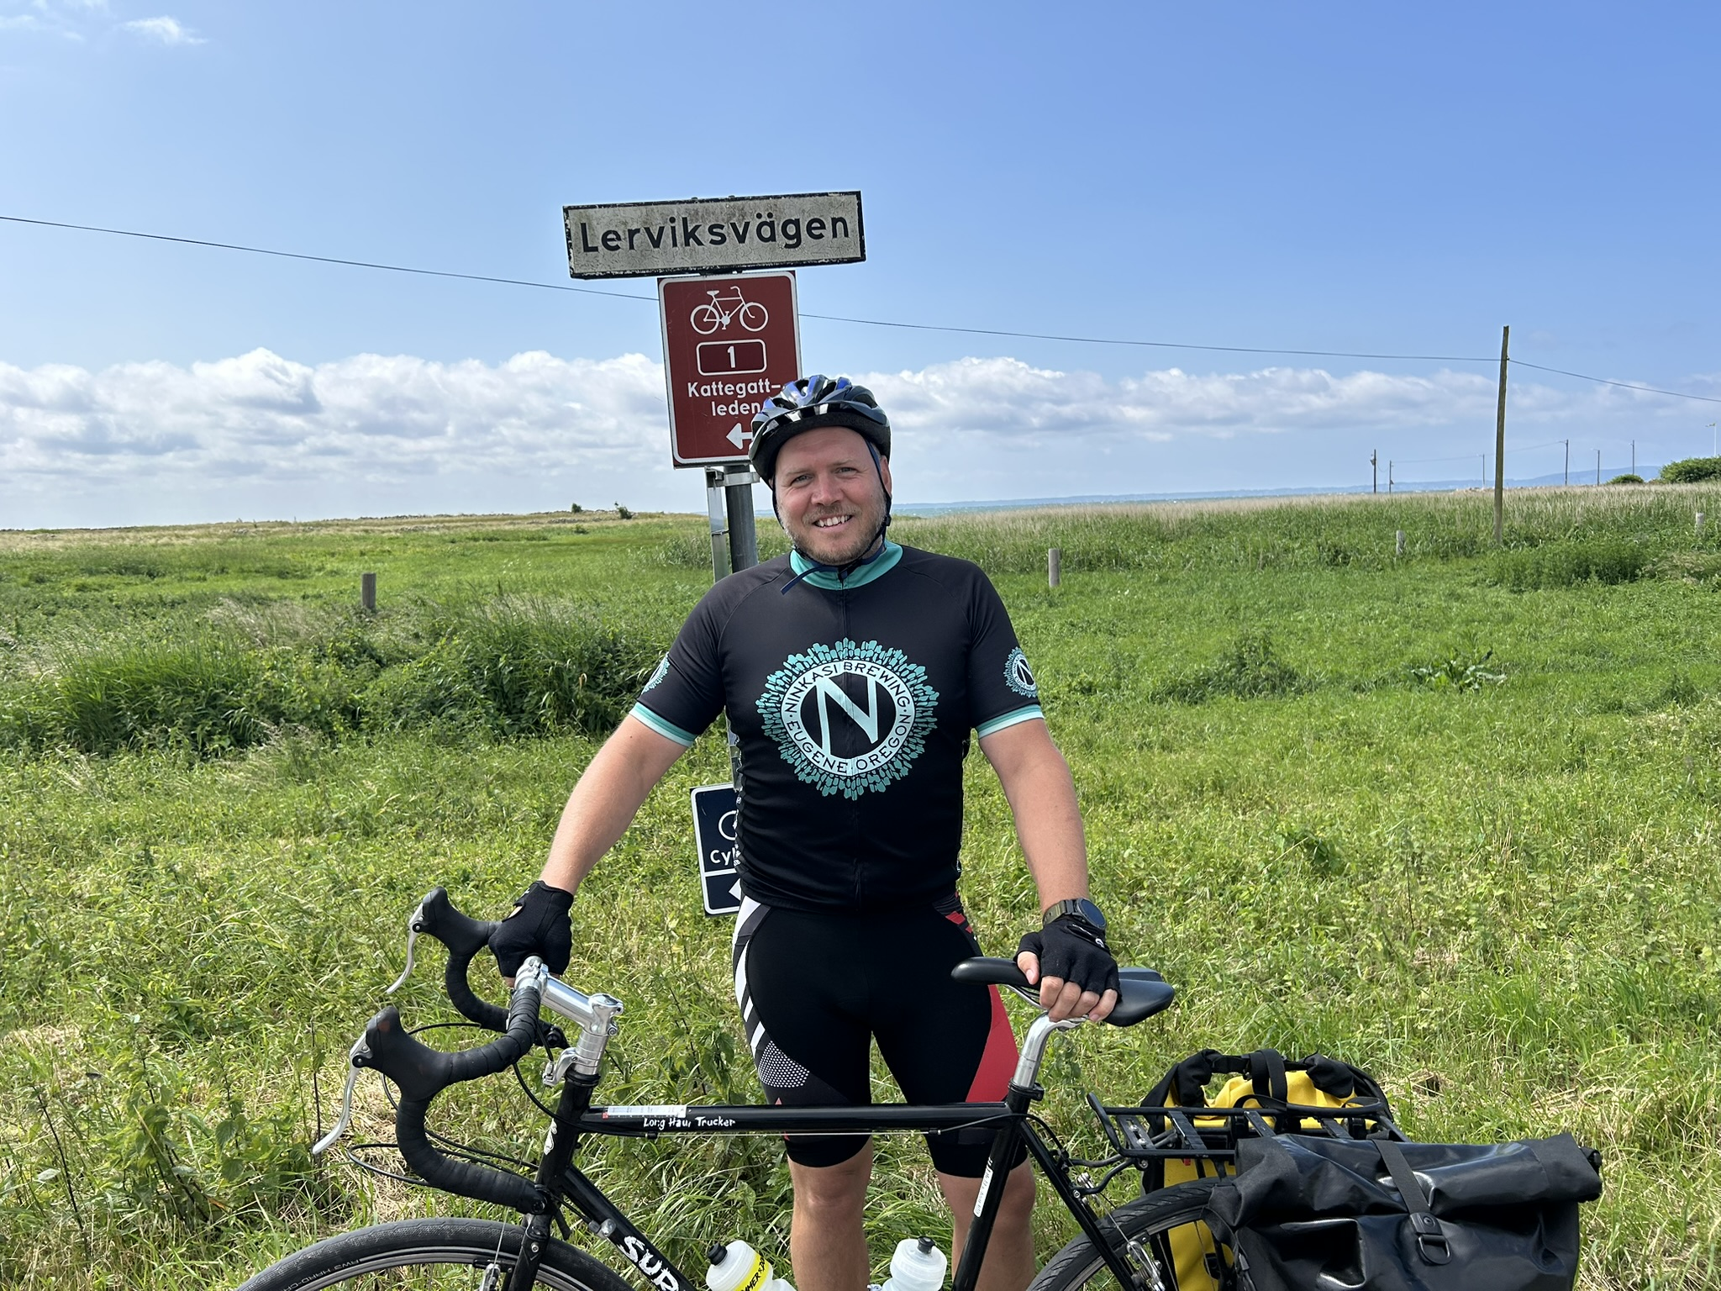


Kattegattleden
390 km

Slide 4
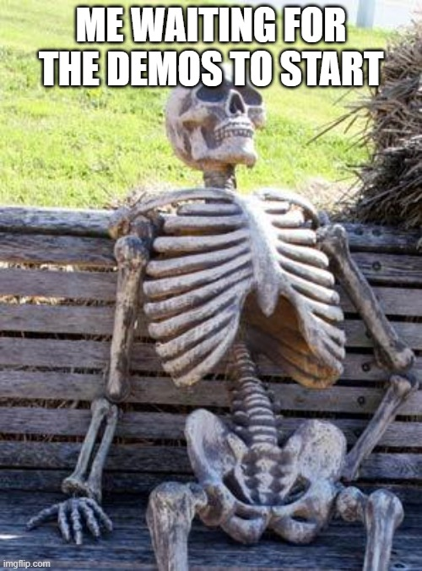
Agenda
Overview of NuGet
Overview of Sleet
Demos

Slide 5
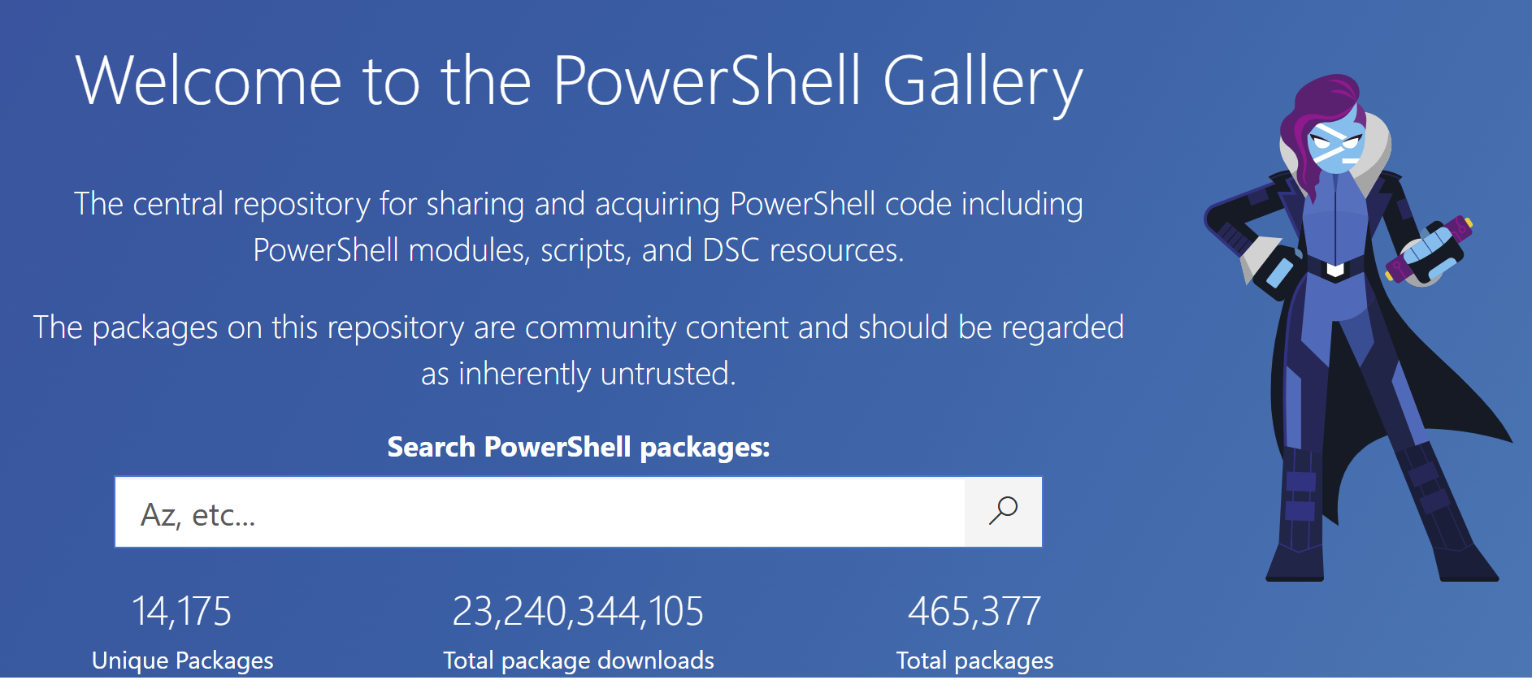

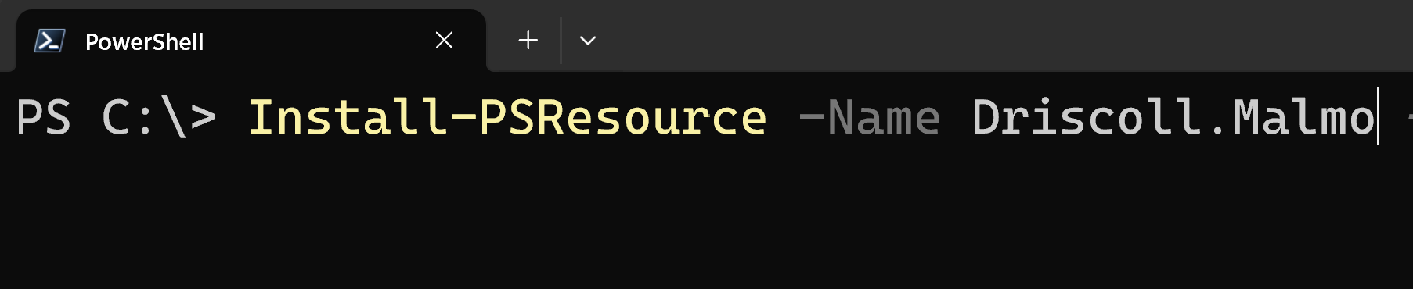
NuGet Bits and Pieces
PowerShell Gallery (NuGet Feed)
Modules (NuPkg Packages)
PSResourceGet (NuGet Client)

Slide 6
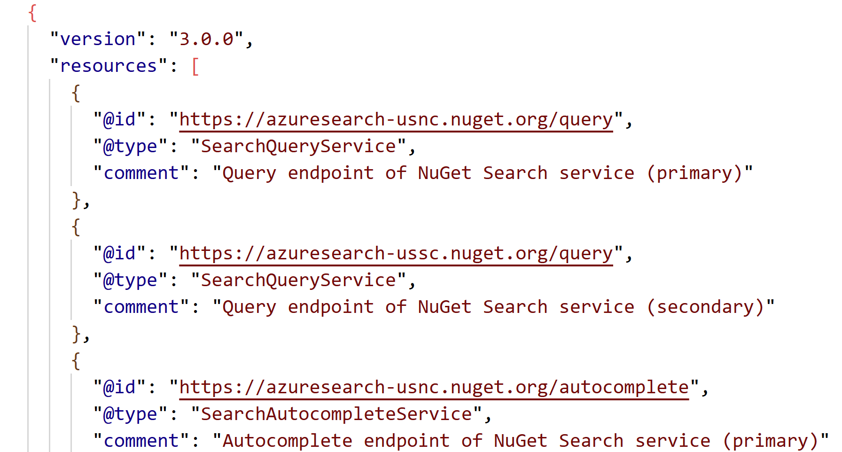
NuGet Protocol
https://api.nuget.org/v3/index.json
https://api.nuget.org/v3/catalog0/index.json
https://api.nuget.org/v3-flatcontainer/owin/index.json
https://api.nuget.org/v3/registration-sample/nuget.versioning/4.3.0.json

Slide 7
NuGet Feeds
NuGet.org (v3 protocol)
PowerShellGallery.org (v2 protocol)
Artifactory
Sonatype Nexus
ProGet

Slide 8
NuGet Clients
Dotnet
NuGet.exe
PowerShellGet (Install-Module)
PSResourceGet (Install-PSResource)
ModuleFast

Slide 9
Why self host?
Internal modules
Vetted modules
Supply chain issues
Redundancy

Slide 10
Sleet
Command Line Tool
Static Package Repository
Azure, AWS and local Support
Optional Search Integration
V3 NuGet Protocol
https://github.com/emgarten/Sleet

Slide 11
Demo
IIS Repository
Publish Module Versions
Azure Repository
Dependencies
Custom Search API

Slide 12
Call to Action
Upvote -> https://github.com/PowerShell/PSResourceGet/pull/1778

